Slide 1
Introduction to HoloLens Development
Hallgeir Gutvik and Gry Nagel, Bouvet
https://github.com/grynag/booster-mr-2019

Slide 2
Notes:
- Satser på nyutdannede, og ansatter mange nyansatte i året, jobber i team
- Ønsker å tette gapet mellom studielivet og arbeidslivet, derfor er vi engasjert i for eksempel dette og....->

Slide 3
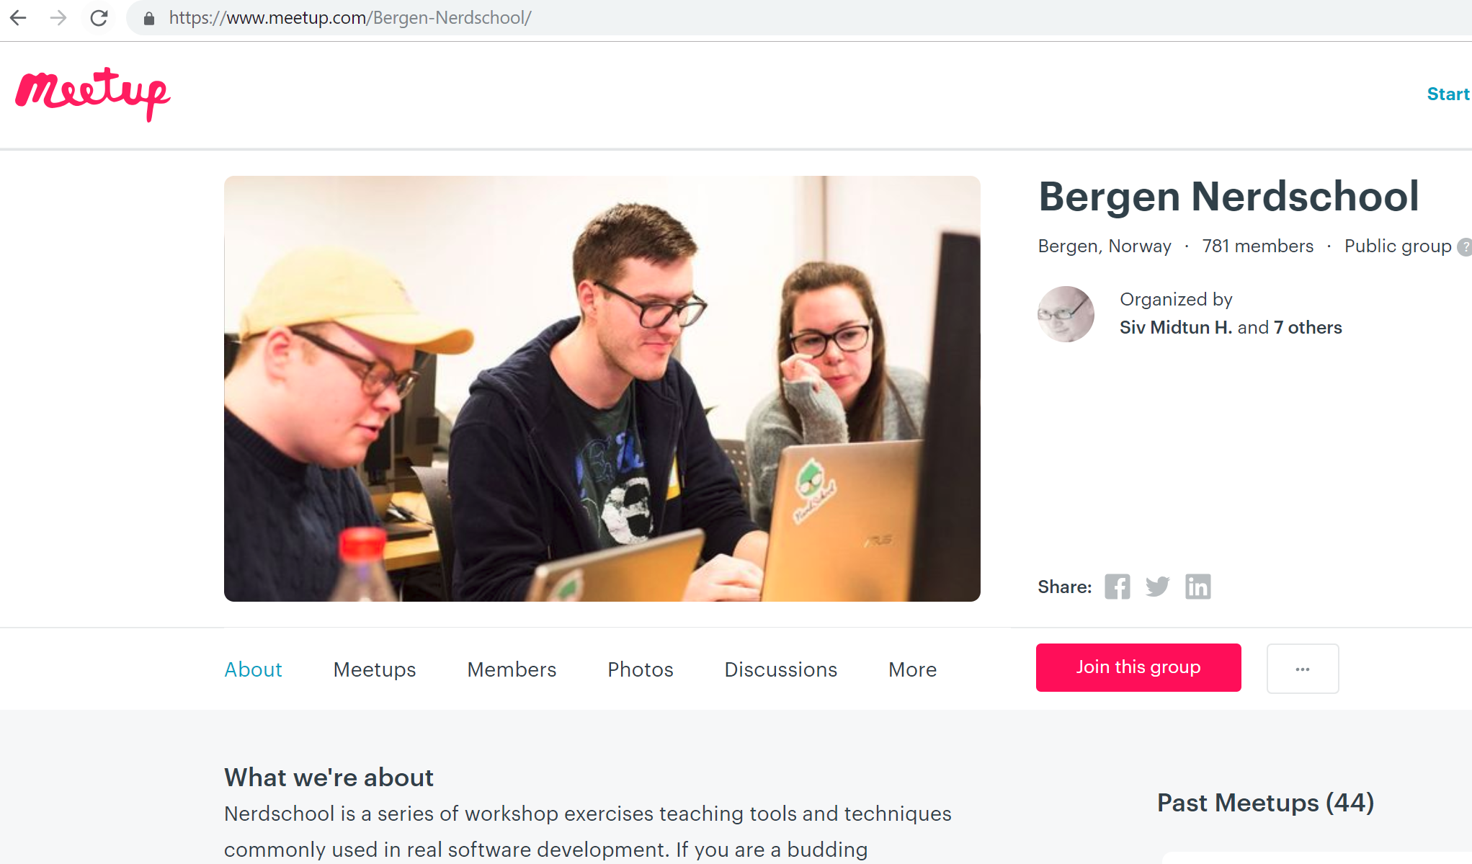

Slide 4
Agenda
Quick introduction of the technology and toolkit
Tasks (https://github.com/grynag/booster-mr-2019 )
If you want: try the HoloLens 1. gen

Slide 5
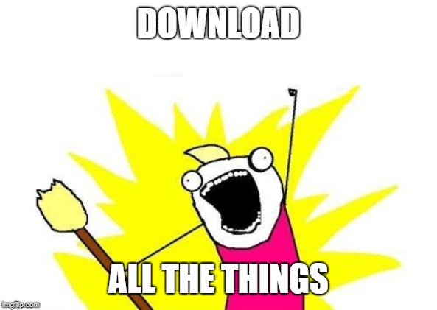
Software requirements
Visual Studio 2017 (Windows 10 SDK)
Unity 2018.3.x
HoloLens emulator
Mixed Reality Toolkit
Find it here: https://github.com/grynag/booster-mr-2019

Slide 6
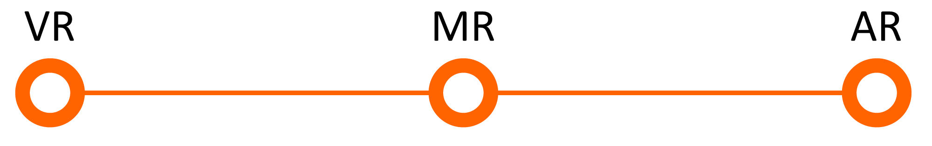
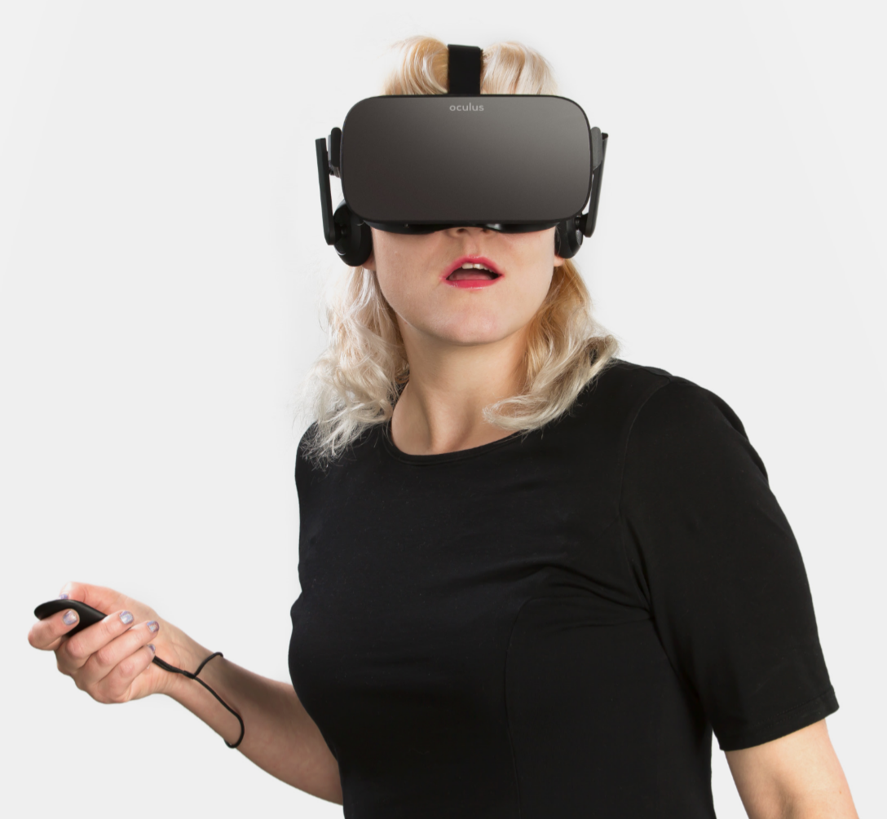
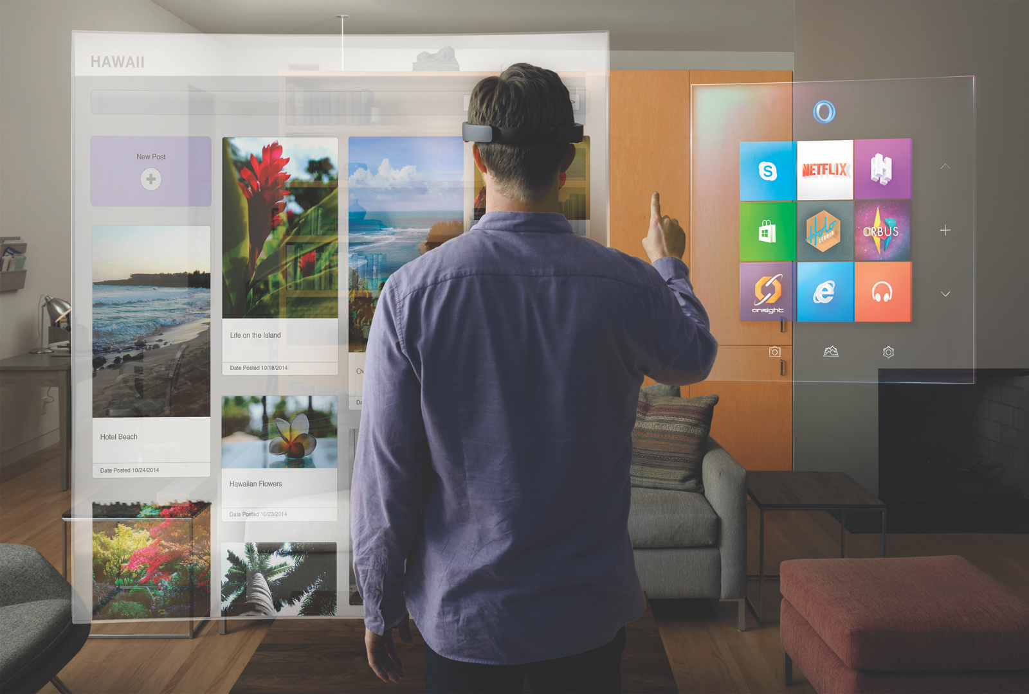
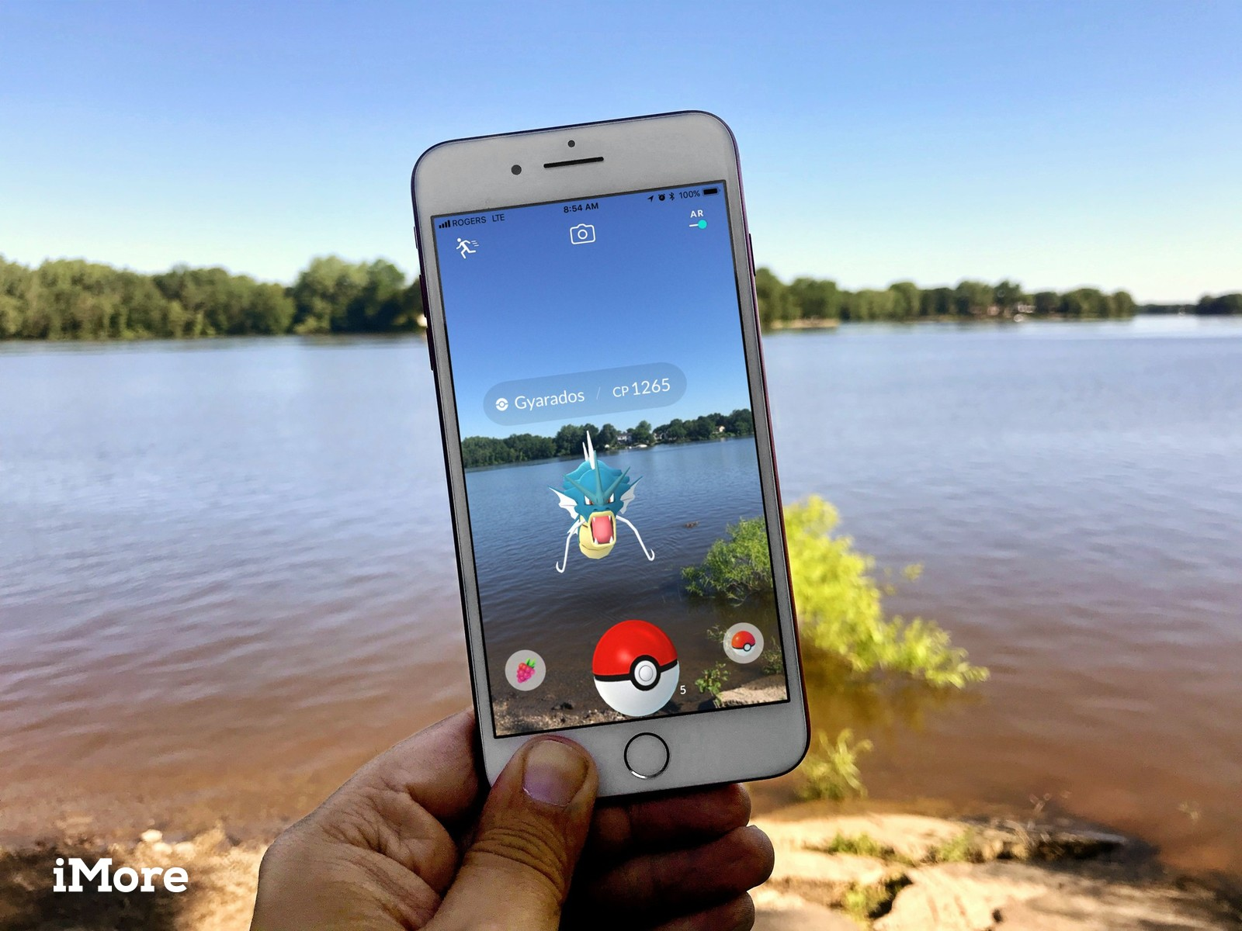
What is Mixed Reality?
Oculus materials used with permission. © 2016 Oculus VR, LLC. All Rights Reserved
Microsoft
IMore
Notes:
VR: replace
AR: add
MR: integrate

Slide 7
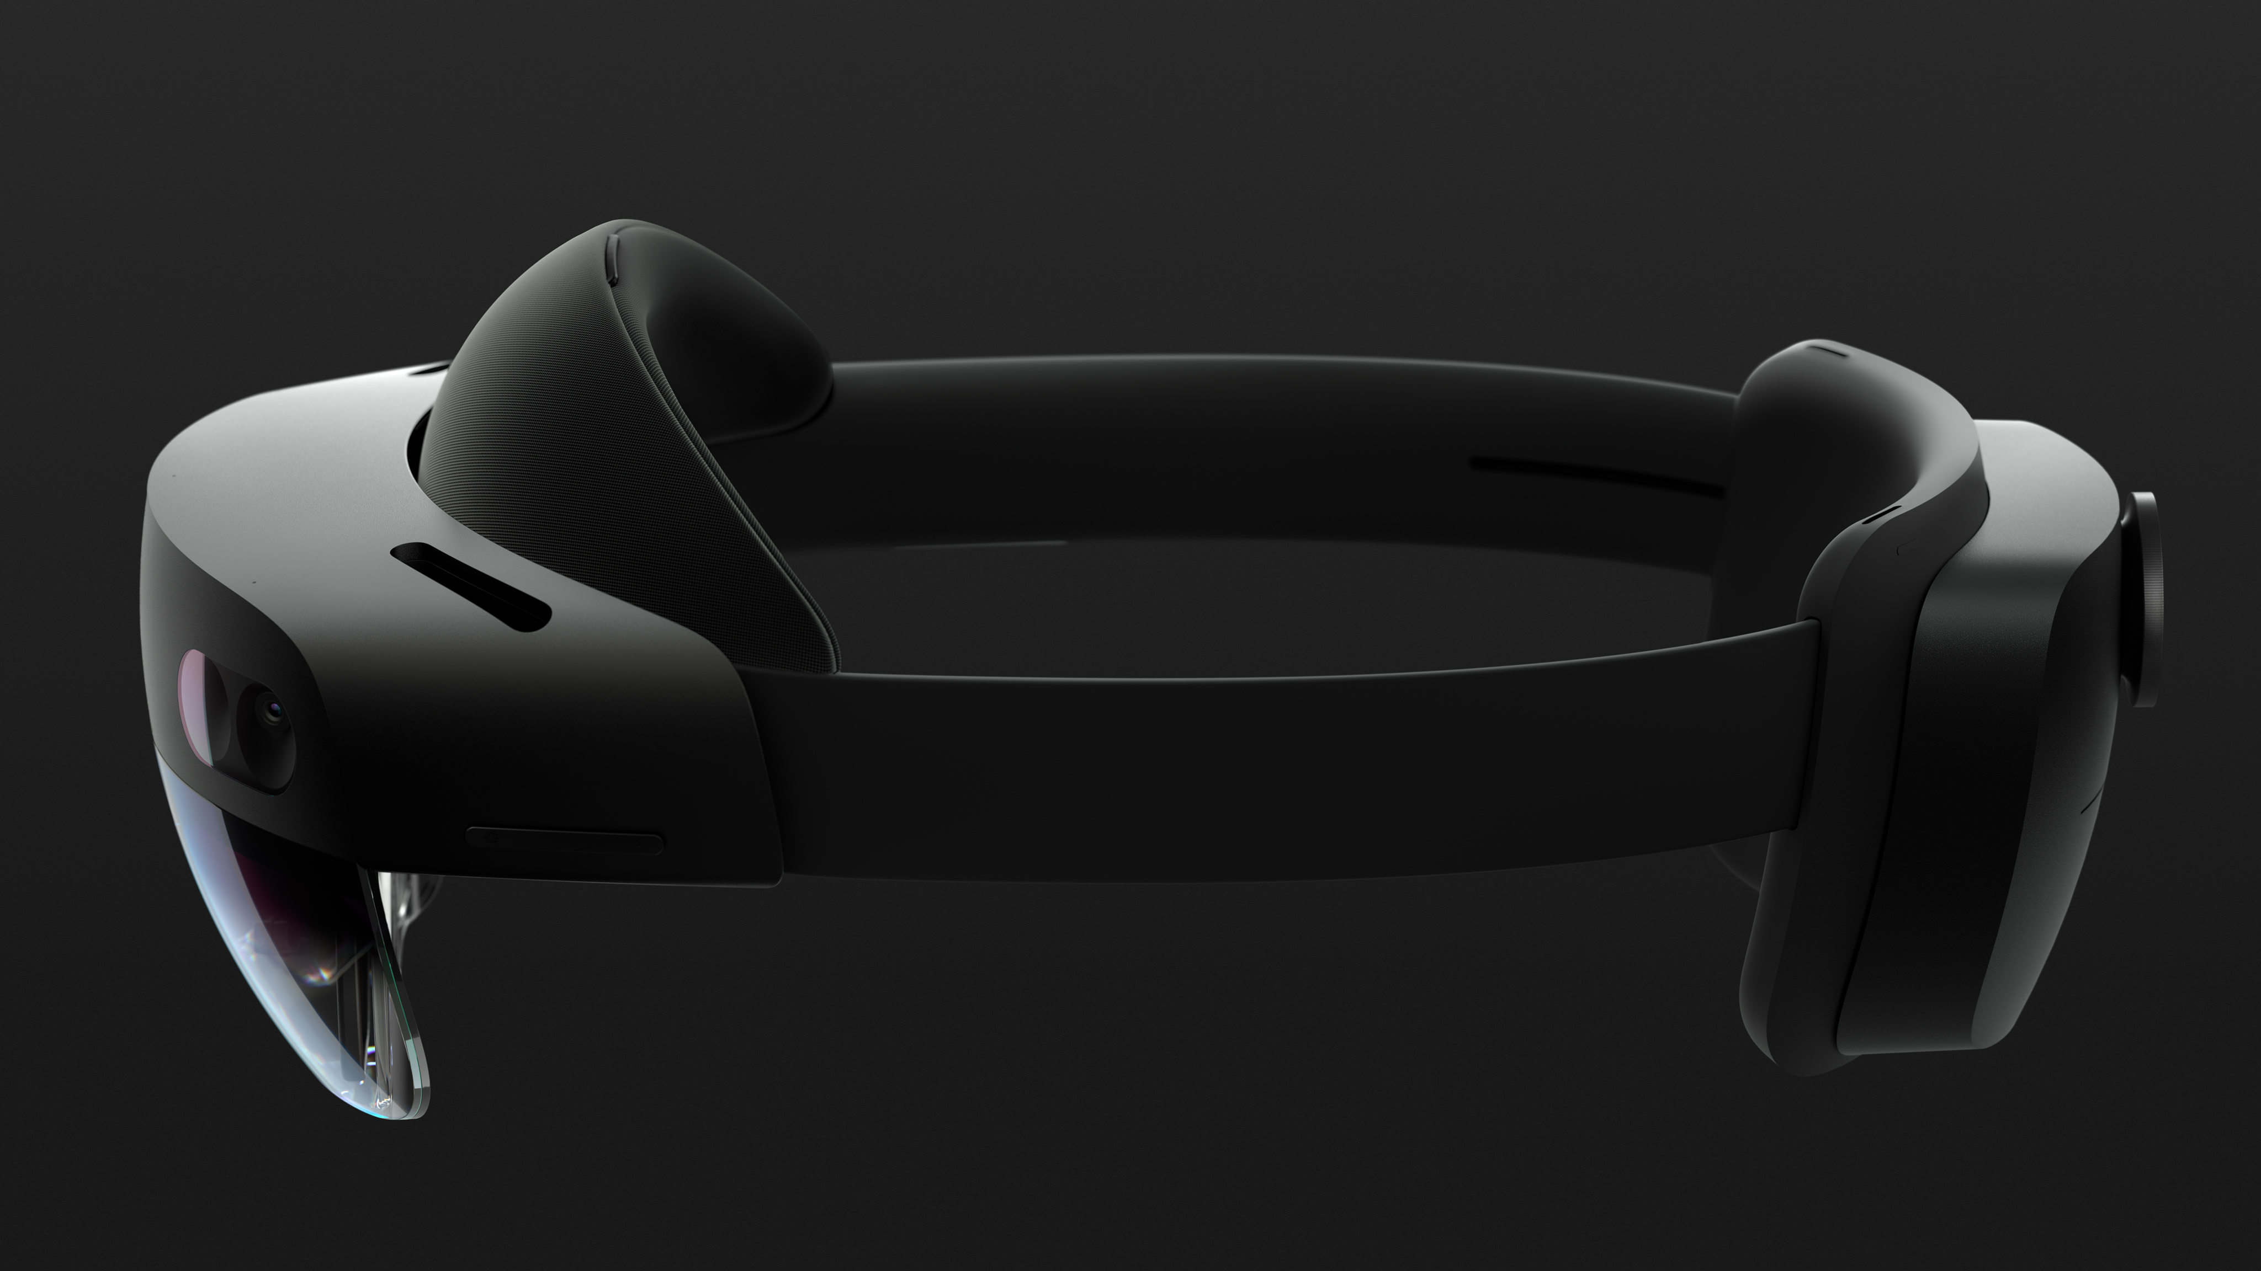
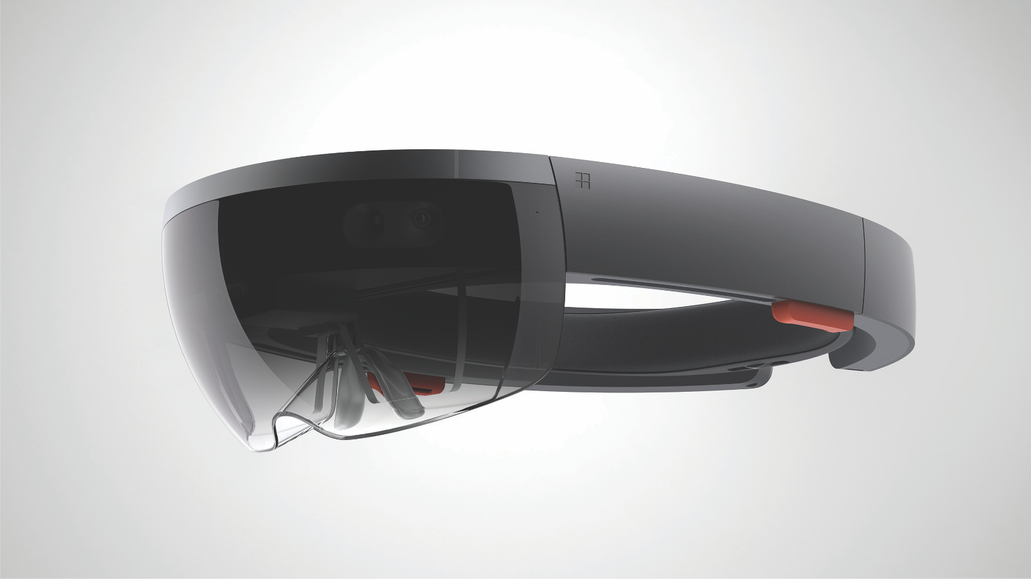
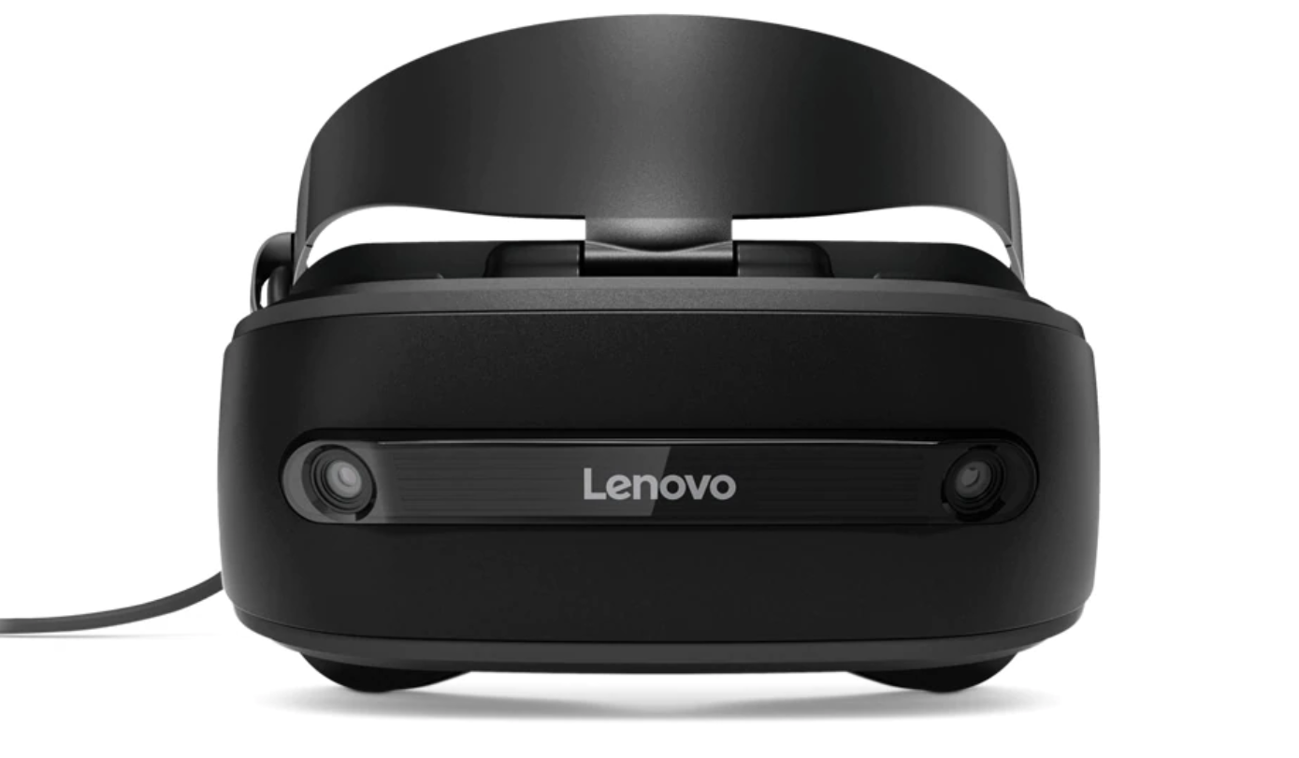
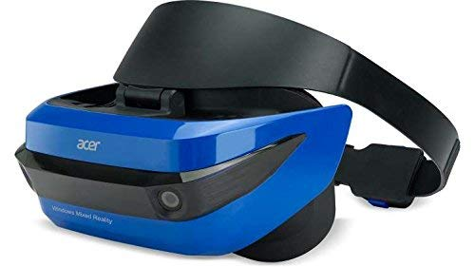
Mixed Reality Devices
Notes:
The most commonly know MR devices is the hololens and now the hololens 2, but Microsoft also offers VR devices like the lenovo explorer. To make development for Mixed reality easyer, Microsoft has created the Mixed Reality Toolkit.

Slide 8
What is the Mixed Reality Tookit?
Collection of scripts and components
Makes the start up easier
Version 2 released October 31th 2018
Notes:
Scripts and components
Sets up the project for you
V2 released october last year
Missing a lot of documentation
I havent tried it before, only used the first version.
Might be the worst/best timing ever to have this workshop, as you will see later
I’m a front-end developer, i dont know much about the building and sdk magic,
Will try to answer questions or help figure stuff out

Slide 9
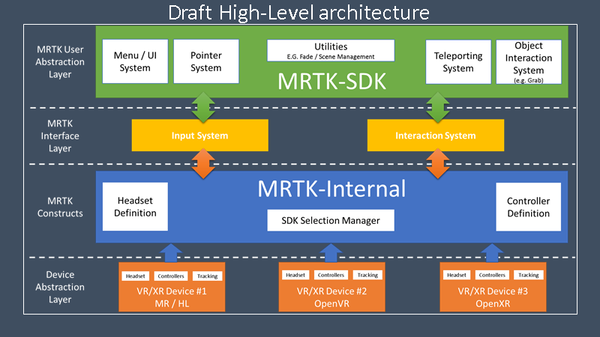
MRTK High-Level architecture
«Out of the box»
Testing
Programmatic interface
Documentation
Standardized examples
Notes:
Device Abstraction Layer
Bridge between external SDK’s and the MRTK to conform output/input. Work for different devices.
MRTK Constructs
Defines interactions with multiple VR/AR platforms.
MRTK Interface Layer
A bridge to coordinate inputs coming from VR devices and controllers.
MRTK User Abstraction layer
The SDK front end. Includes pre-build components. Easy to use components/scripts.
“Out of the box”
Everything should have tests
Programamatic inferface
Documentation
Standarlized examples
The new framework needs to provide “out of the box” components to enable rapid prototyping and development. Future internal changes should not break these components or cause them to degrade in functionality.
Every component / feature provided by the framework (either prefab or script) should have corresponding unit tests to validate its functionality. Any future merge to the framework will have to validate these test before merging to ensure there is no degradation of service.
The new framework should provide a programmatic interface along side the SDK components, to enable advanced users to extend or replace any component within the framework.
Each new interface / component should be fully documented (where possible). These should detail all interactions and intended uses. For the advanced cases, we’ll need to review how we explain how to replace components (e.g. replacing the input system with another, like InControl)
Working examples / demos should be created for any specific system, these should have purpose and not just be a “test”.
All testing components / scripts / prefabs / scenes should only be retained in the dev branch. The master branch should only contain the “ToolKit” and working examples. Master is for consumers only.
Simulator options need to be provided as another device. This will also form the template for new MR/XR/VR devices / SDKs.

Slide 10
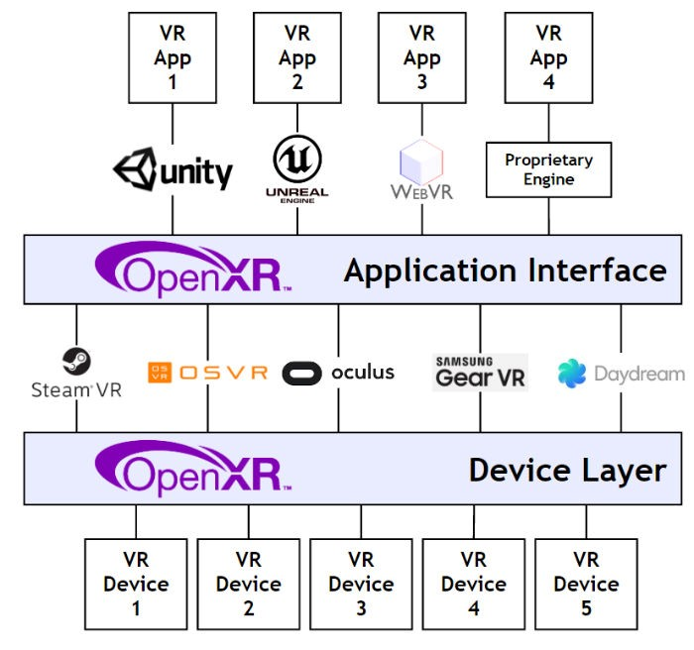
Cross-device
Notes:
The new MRTK approach would span across the Application and SDK/Device layers, seeing how OpenXR is a Device to the new architecture.

Slide 11
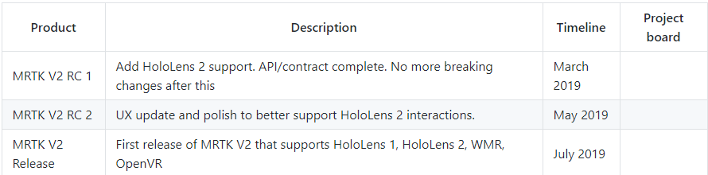
Mixed Reality Toolkit Roadmap
Notes:
What I mean with best/worst timing. The next version will be released by the end of march. Will include documentation

Slide 12
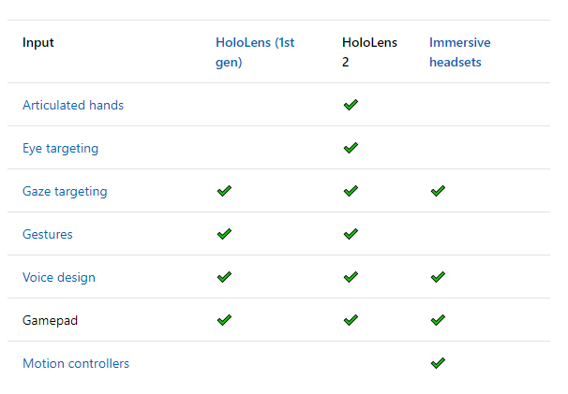
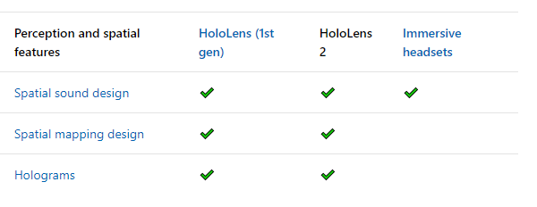
HoloLens features

Slide 13
A few notes
The MRTK is in beta, that means that there are bugs
It is not possible to test input with mouse and keyboard in Unity as of now (not been merged in to the public repo yet)
A lot of stuff is currently missing

Slide 14
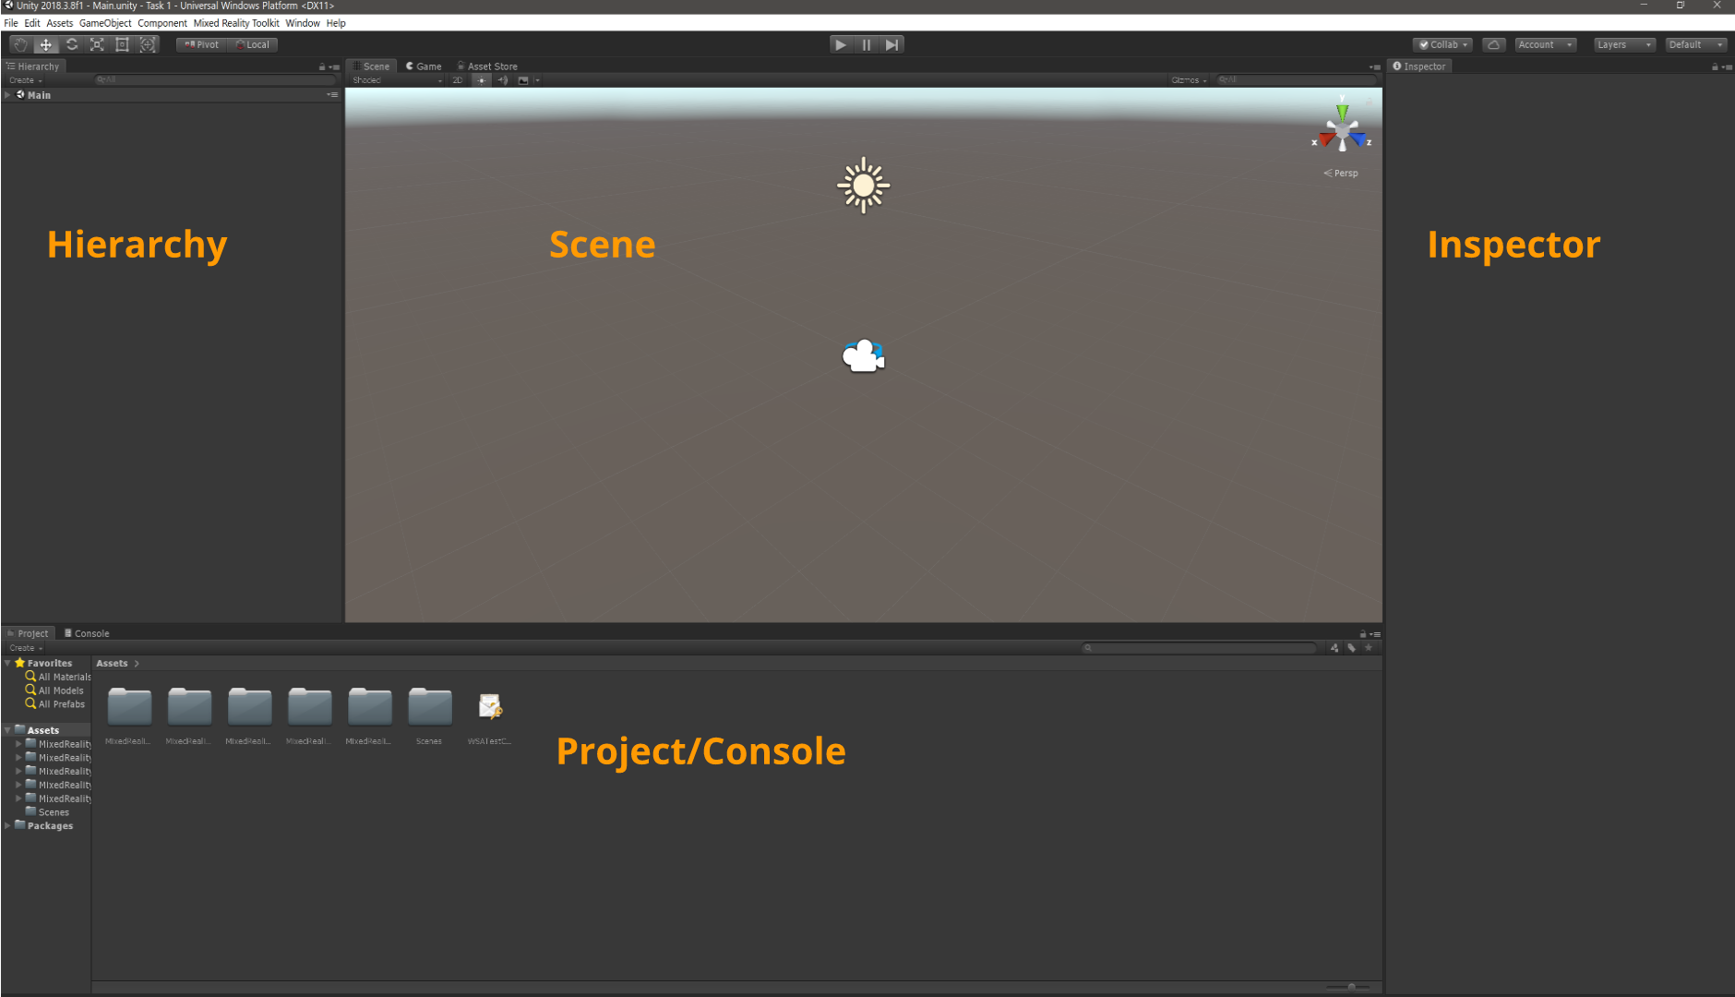
Unity

Slide 15
Two key consepts
Prefab
Scripts (C#)

Slide 16
Mixed Reality Design
Test your application often on the HoloLens
Notes:
Small big, interactions

Slide 17
Tasks
Create new Mixed Reality project in Unity
Adding a 3D model and using manipulation and tool tips from the MRTK
Deploying to the HoloLens emulator
Choose the tasks that suit you
Tasks here: https://github.com/grynag/booster-mr-2019

